Slide 1
Redefining Iron Supplementation
Pale to pink –
time to think
Dr. Jyothika Desai
Bengaluru

Slide 2
Iron deficiency with anemia - IDA
Iron status
Iron deficiency without anemia - ID
Normal Iron with varying amounts of stored iron - N
Iron deficiency
Iron deficiency anemia
Total population
Iron deficiency is 4 times more common than Iron deficiency anemia
Iron overload

Slide 3
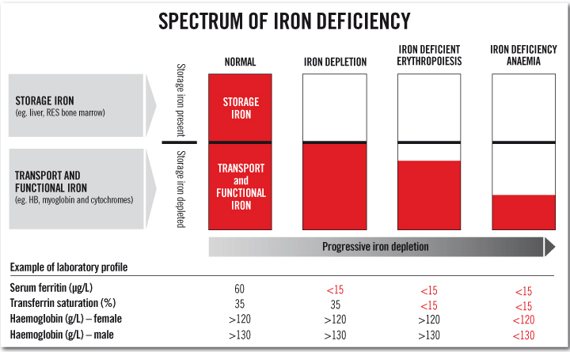

Slide 4
The 3 Stages of Iron Deficiency Anaemia

Slide 5
Iron Deficiency
Prevalence: Iron deficiency is 4 times more common than Iron deficiency anemia
Hemoglobin can be normal
Compromised supply of iron to tissues
Decreased or depleted iron stores
Consequences are similar to anemia: fatigue, impaired concentration, decreased work productivity

Slide 6
Iron Deficiency Anemia
In India, up to 88% of pregnant and 74% of non-pregnant women have Iron Deficiency Anemia
WHO

Slide 7
Why is iron important?
Iron has many functions in the body:
In Hemoglobin, to transport oxygen to the cells
In myoglobin, for oxygen to muscle
In cytochromes, for biochemical reactions
For the synthesis of neurotransmitters for brain function
For DNA synthesis, to make new cells
For immune function to fight infection

Slide 8
Functional consequences of Iron deficiency
Delayed psychomotor development – lower IQ in children
Impaired immune status – morbidity from infections
Impaired muscle function – poor work performance
Altered hormone production (thyroid), myelination & metabolism (neurotransmitters) – poor co-ordination
Impaired DNA replication and repair – poor healing
Increased GI absorption capacity – heavy metal poisoning

Slide 9
In Pregnancy
IDA wreaks havoc in pregnancy: increases
maternal & perinatal morbidity & mortality
ID without anemia also wreaks havoc:
– lowers the QOL, expressed as DALY

Slide 10
Disability Adjusted Life Year: DALY
It is a measure of overall disease burden, expressed as the number of years lost due to ill-health, disability or early death.
It is an expression of years of life lost (YLL) and years lived with disability (YLD).
DALYs provide an overall view of the magnitude of economic losses to a population
DALY = YLL + YLD

Slide 11
Tests to assess iron status
Complete blood count (CBC)
Peripheral smear
Red cell indices: MCV, MCH
Serum iron, total iron-binding capacity (TIBC), and serum ferritin
Hemoglobin electrophoresis and measurement of hemoglobin A ₂ and fetal hemoglobin
Reticulocyte hemoglobin content
Bone Marrow stainable iron

Slide 12
Test Results indicating Iron Deficiency
Serum Ferritin: <15ng- 20ng/mL (N- 40-160ng/dl)
Low Serum iron: (N- 65-165ug/dl)
Elevated Transferrin (TIBC): (N- 300-360ug/dl)
Low Transferrin saturation: <16% (N- 35 -60%)
Serum Transferrin Receptors: Elevated. Early indicator, unaffected by infection or inflammation
Bone marrow stainable iron: absent in depleted iron stores
Red cell Protoporphyrin: 80 µg/d ( N-30ug/dl)
Notes:
in the presence of infection, malignancy or chronic inflammation, the ferritin rises as it is an acute phase protein

Slide 13
5 decades of various oral irons have failed to eradicate anemia
What’s the way forward??
Parenteral iron?
Newer preparations of oral iron?
Novel ideas, any?

Slide 14
Intravenous iron?

Slide 15
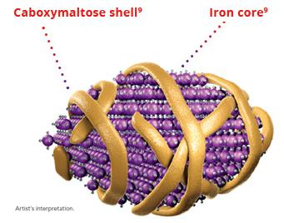
IV iron
IV iron formulations contain an iron core stabilized by a carbohydrate outer shell that maintains iron in a colloid form and controls its release
Formulations differ in iron core size and in the type and density of the surrounding carbohydrate shell
Iron Sucrose
Ferric Carboxymaltose FCM
Ferumoxytol
Iron isomaltoside IIM
Notes:
Ferumoxytol is used mostly in pts with CKD

Slide 16
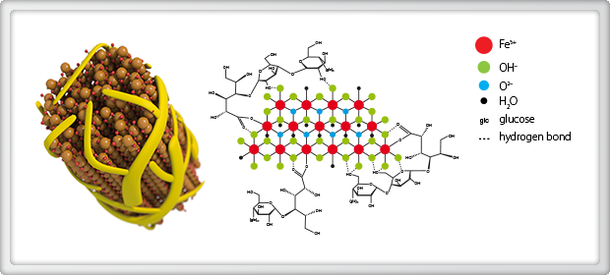
IV Ferric Carboxymaltose
FCM
Safe, swift and sure, this is the first high-dose, non-dextran IV iron indicated for a "broad patient population" with IDA
It elicits a 5-fold erythropoietic response in normal individuals
US FDA & DCGI approved

Slide 17
Therapy:
Supplied as 500mg and 1000mg vials
Maximum dose 1000mg in one week
IV infusion over 15 to 20 minutes, in NS only
If needed, injection may be rpted
FCM
Response:
Patients report a feeling of wellness in 3 – 4 days
Reticulocytosis in 5 – 7 days
Rise in hemoglobin in 10 – 12 days, continues
Improvement in red cell indices in 10 – 12 days

Slide 18
Is FCM safe during pregnancy?
Safe when given in 2nd and 3rd trimesters
FCM 500mg or 1000mg may be given
Improves the iron status in 2 weeks, to safe levels
Reduces maternal morbidity – avoids blood transfusion
Averts maternal mortality
Gives a better iron status to the newborn
50–90% are IDA
The rest are ID
29.8% of women who were not previously anemic during pregnancy become anemic after delivery
- Pregnancy nutrition surveillance 2007 report

Slide 19
Adverse events?
Exceeding the daily dose of iron that can be administered safely:
up to 1000 mg iron in one infusion
not more than 1000 mg in one week [subject to a maximum of 15 mg/kg for low weight patients
not to exceed 500 mg if patient weighs < 35kg
Not following the recommended rate of infusion:
500 – 1000 mg infused in minimum of 15 minutes
Not following the recommended dilution: solutions less than 2 mg/ml are not recommended
Not following the right diluent: normal saline is the ONLY recommended diluent
Parenteral iron must be avoided in cases of infection, asthma, allergies
Not following the recommended storage conditions: cool [8-25°C] and dark place; do not refrigerate or freeze

Slide 20
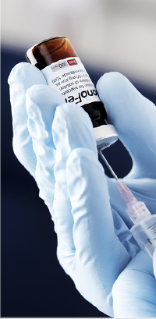
Caution?
Can cross placenta; use during pregnancy may affect skeletal development in the fetus (transient unexplained hypophosphatemia at two weeks after injection)
Iron may serve as a growth factor for bacteria, inhibit phagocytosis, and increase oxidative stress Withhold IV iron therapy in cases of acute infection

Slide 21
Newer salts of oral iron?

Slide 22
Ferrous Ascorbate
It utilizes the benefits of ascorbate in iron absorption
Ascorbate increases the absorption of non-heme iron by reducing the ferric to ferrous form and by preventing oxidation of ferrous iron due to ingested phytates & phosphates
Better compliance, greater bioavailability
Greater increase in hemoglobin, serum Ferritin
M. B. Agarwal, S. A. Rathi. An open label, Randomized, comparative clinical study to assess the efficacy and tolerability of ferrous ascorbate versus carbonyl iron in the treatment of IDA. JOGI, 2006, 9, 13-20.
The HERS Trial Report, IJOG India, July – August 2005. Vol 8, No. 4
Valenzuela et al., 2013
Notes:
Therapeutic
doses of iron should increase hemoglobin levels by 0.7-
1.0 g/dL per week. To minimize side effects, iron supplements are often
taken with food. This may decrease iron absorption by as
much as 40-66%.

Slide 23
The new kid on the block- Ferric Maltol
FDA approves Ferric Maltol for the treatment of Iron Deficiency in adults 30mg bd orally for 12 weeks on empty stomach
Not absorbed systemically as an intact complex, so fetal exposure to drug unlikely

Slide 24
Elemental Iron in Oral preparations
Iron Supplement Tablet Size Elemental Iron
Ferrous fumarate 325 mg 108 mg
Ferrous sulfate 325 mg 65 mg
Ferrous gluconate 325 mg 35 mg
Iron bisglycinate 25 mg
Iron Protein Succinylate 300 mg 18 mg
Notes:
e Centers for Disease
Control and Prevention (CDC) recommends 50-60 mg of
oral elemental iron twice daily for three months for the
therapeutic treatment of iron deficiency anemia.1
However, this dosing regimen has recently been
questioned. Iron supplements of 60 mg Fe as FeSO4
increase hepcidin for up to 24 hours and are associated
with lower iron absorption on the following day. Twice daily supplementation seems to
have limited additional effect compared with daily
administration and may increase gastrointestinal sideeffects. In fact, alternate-day schedules of iron
administration may maximize fractional absorption,
increase dosage efficacy, reduce gastrointestinal
exposure to unabsorbed iron and ultimately improve
tolerance of iron supplements

Slide 25
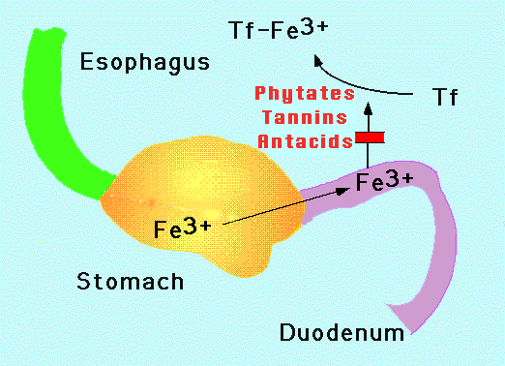
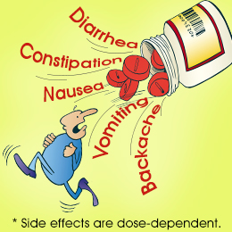
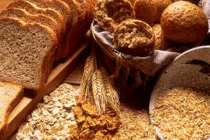
Iron supplements
Side effects… tolerance???
Conventional iron absorption
Hindrances to
iron absorption
Notes:
When it comes to conventional iron supplements we are well aware about the absorption mechanism, the various factors which can interfere with iron absorption such as phytates, tanins, polyphenols (tea, coffee), PPIs, high gastric pH, calcium and also the typical side effects or GI disturbances
that may be seen with conventional iron.

Slide 26
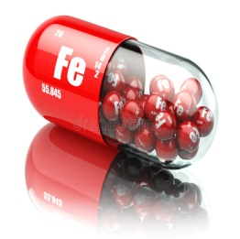
Oral Iron is not reaching its destination!
Bone marrow
GI Tract - faeces

Slide 27
What we already know…
Problems with Absorption of Conventional Iron
01
Reduced absorbtion when taken with food
02
Taking Twice a day reduces absorption
03
Taking higher doses causes G-I side-effects
04
Reduced absorption in Infections, inflamm
05
Poor Compliance
Koenig MD, Nutrients. 2014 Aug 4;6(8):3062-83; Gautam CS, et al. Medscape J Med. 2008;10(12):283; Nagpal J, et al. Indian Pediatr. 2004 Aug;41(8):807-15; Di Renzo GC, et al. Womens Health (Lond). 2015 Nov;11(6):891-900; Khalafallah AA, et al. Pregnancy. 2012;2012:630519; Milman N. J Pregnancy. 2012;2012:514345; Yu PP,, et al. J Pharma Care Health Sys 2015. S4:1-3.
Notes:
Conventional iron absorption is associated with various problems like:
Phytates, phenols and tannins inhibit absorption of iron
Ferric iron salts needs to be converted in to ferrous form to be absorbed
Gastric acidity and ascorbic acid necessary for absorption
Other divalent metal ions (e.g. Zn2+, Mn2+) may interfere with absorption of iron and vice versa
High hepcidin levels may restrict absorption of iron

Slide 28
What we already know…
Problems with Absorption of Conventional Iron
01
Phytates, phenols and tannins inhibit absorption of iron
02
Ferric iron salts needs to be converted in to ferrous form to be absorbed
03
Gastric acidity and ascorbic acid necessary for absorption
04
Other divalent metal ions (e.g. Zn²⁺, Mn²⁺) may interfere with absorption of iron and vice versa
05
High hepcidin levels may restrict absorption of iron
Koenig MD, Nutrients. 2014 Aug 4;6(8):3062-83; Gautam CS, et al. Medscape J Med. 2008;10(12):283; Nagpal J, et al. Indian Pediatr. 2004 Aug;41(8):807-15; Di Renzo GC, et al. Womens Health (Lond). 2015 Nov;11(6):891-900; Khalafallah AA, et al. Pregnancy. 2012;2012:630519; Milman N. J Pregnancy. 2012;2012:514345; Yu PP,, et al. J Pharma Care Health Sys 2015. S4:1-3.
Notes:
Conventional iron absorption is associated with various problems like:
Phytates, phenols and tannins inhibit absorption of iron
Ferric iron salts needs to be converted in to ferrous form to be absorbed
Gastric acidity and ascorbic acid necessary for absorption
Other divalent metal ions (e.g. Zn2+, Mn2+) may interfere with absorption of iron and vice versa
High hepcidin levels may restrict absorption of iron

Slide 29
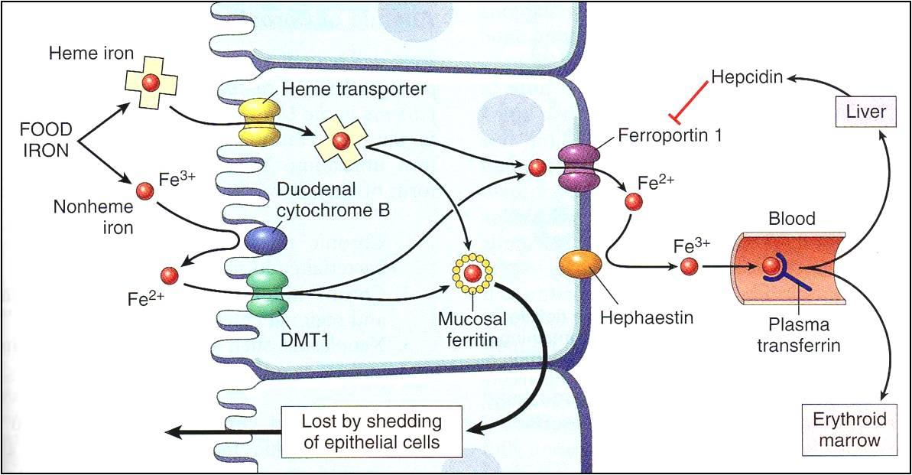
What we already know…
Conventional iron absorption - through enterocytes of duodenum in the small intestine
Fe⁺³ is reduced to Fe⁺² which enters the enterocyte via DMT1
Hephaestin converts Fe²⁺ to Fe³⁺
Ferroportin (iron exporter) transports Fe³⁺ into blood
Transferrin carries Fe³⁺ towards bone marrow for erythropoiesis
Mackenzie B, et al. Am J Physiol Gastrointest Liver Physiol. 2005 Dec;289(6):G981-6.

Slide 30
Iron absorption is regulated!
If binding capacity of transferrin is exceeded,
Iron is deposited in tissues - free radical damage
Too much iron
Too little iron
Tissue and organ damage
Cellular dysfunction, anemia
What decides all this?
Hepcidin
Notes:
Iron concentration in plasma is regulated to remain within the range of approximately 10-30 uM. Persistently high concentrations of iron in plasma that exceed the binding capacity of transferrin lead to deposition of iron in tissues with resulting tissue and organ damage. Low plasma concentrations of iron limit iron delivery to cells and cause cellular dysfunction. Persistent limitation of iron supply to the bone marrow causes anemia.

Slide 31
Hepcidin – can affect the efficacy of iron repletion via supplemental or dietary sources
Hepcidin is produced in the liver in response to
1. increasing iron stores
2. it is also induced by interleukin-6 (IL-6) in infectious and inflammatory diseases
Hepcidin restricts both
1.iron absorption and
2.iron release from stores
Koenig MD, et al. Nutrients. 2014 Aug 4;6(8):3062-83.
Petkova-Marinova & Ruseva, Relationship of hepcidin levels to parameters of iron metabolism during pregnancy. Article in Archives of the Balkan Medical Union, June 2015
Notes:
Production of hepcidin is controlled by plasma iron concentrations, erythropoetic activity and inflammation.
Low erythropoeitic activity, high plasma iron and inflammation or infection in the body activates liver to produce hepcidin resulting into reduced ferroportin expression. In contrast, when iron stores are low or anaemia is present, hepcidin levels are decreased which allows increased iron absorption from intestine and mobilisation of iron stores to plasma through ferroportin. Thus hepcidin concentration markedly influences the iron absorption from intestine and can also affect efficacy of oral iron supplements.

Slide 32
Hepcidin – the security check for iron overload
Hepcidin, a peptide hormone, is the master regulator of systemic iron bioavailability by
REGULATION OF TRANSMEMBRANE IRON TRANSPORT
Hepcidin binds to FERROPORTIN and forms hepcidin-ferroportin complex, which is degraded in the lysosomes and iron is locked inside the cells (mainly enterocytes, hepatocytes and macrophages).
It limits the transfer of iron from gut cells to blood. The absorbed iron gets lost in stool when the cells are shed
Koenig MD, et al. Nutrients. 2014 Aug 4;6(8):3062-83.
Petkova-Marinova & Ruseva, Relationship of hepcidin levels to parameters of iron metabolism during pregnancy. Article in Archives of the Balkan Medical Union, June 2015
Notes:
Hepcidin, a peptide hormone is the master regulator of systemic iron bioavailability
Hepcidin binds to FERROPORTIN and forms hepcidin-ferroportin complex, and iron is locked inside the cells.

Slide 33
When Hepcidin goes haywire…
Iron
Normal homeostasis
Hepcidin
Hereditary haemochromatosis
Iron-overloading & toxicity
Anemia of Inflammation, Chronic diseases
Hepsidin production is more
Ganz T. J Am Soc Nephol. 2007;18:394-400.
Ganz T, Nemeth E. Am J Physiol Gastrointest Liver Physiol. 2006;290:G199-G203.
Notes:
Dysregulation of hepcidin gives rise to a variety of iron disorders. In anemia of inflammation, iron-refractory iron deficiency anemia and hepcidin-secreting tumors, hepcidin production is inappropriately high, iron concentrations in plasma decrease and the supply of iron for is restricted, causing anemia. In hereditary hemochromatosis and iron-loading anemias hepcidin production is inappropriately low and iron absorption and cellular release are increased. Plasma iron concentrations are high causing tissue iron overload and iron toxicity.

Slide 34
What happens to Hepcidin levels during pregnancy?
Hepcidin is lower in pregnancy than in the NPS - to ensure greater iron bioavailability to the mother and fetus
Hepcidin levels decrease as pregnancy progresses, with the lowest hepcidin levels observed in the third trimester, as fetal demand for iron is greatest in the third trimester
Koenig MD, et al. Nutrients. 2014 Aug 4;6(8):3062-83.
Notes:
During pregnancy, hepcidin levels decrease as pregnancy progresses, with the lowest hepcidin levels observed in the third trimester.
The increased need for fetal iron in the third trimester may be responsible for the decrease in maternal hepcidin observed, as fetal demand for iron is greatest in the third trimester.

Slide 35
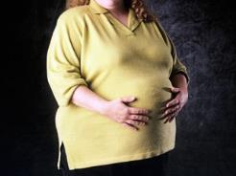
When is Hepcidin level high in pregnancy?
Inflammatory states during pregnancy are associated with higher hepcidin levels, which include:
Obesity
Gestational diabetes
Preeclampsia
Malaria
Inflammation is a known regulator of hepcidin production
Koenig MD, et al. Nutrients. 2014 Aug 4;6(8):3062-83.
Notes:
But, in high-risk pregnancies, such as those associated with inflammatory conditions (e.g., obesity or preeclampsia) and in malaria infection hepcidin was found to be elevated compared to healthy pregnancies.
This is because inflammation is a known regulator of hepcidin production.

Slide 36
How can we get Iron into the system avoiding Hepsidin?

Slide 37
A hormone that regulates Hepcidin
- Erythroferrone

Slide 38
A Hepcidin antagonist:
PRS - 080
Has just been through Phase I trials in healthy human subjects
57th Annual meeting of American society of Hematology Orlando FL, Dec 7th 2015
Hepcidin antagonist is a long … way off

Slide 39
Sucrosomial Iron / Liposomal Iron: the smart iron!
Packaged differently
Delivered differently

Slide 40
What’s new in the age-old iron supplementation?
A new way to deliver iron… ??
A novel route of iron absorption… other than enterocyte mediated, transporter dependent iron absorption??
Is it possible?
Minimizing GI side-effects…??

Slide 41
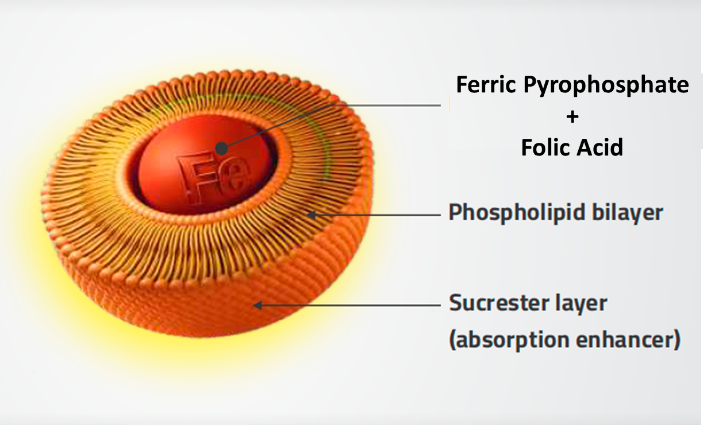
I-seal iron
New-generation oral iron with revolutionary I- seal Technology
Data on file;
Barni S. Expert Review of Hematology. 2016;9:sup1, 1-42.
Notes:
The I-seal iron is delivered using I-seal technology wherein Ferric pyrophosphate and folic acid are covered by phospholipid layer (Liposome) plus sucrose esters of fatty acid matrix (sucrester layer).
This is a diagramatic representation of Ferric pyrophosphate and folic acid, covered by sucrosoma.
The sucrosoma is formed by a liposome which is a spherical structure of phospholipids similar to biological cell membranes. These liposomes are again immersed in a matrix of sucrose esters of fatty acids (sucrester) to form surosoma. The sucresters are obtained by esterification of fatty acid with sucrose. They are commonly employed as food emulsifiers and food additives in industry.

Slide 42
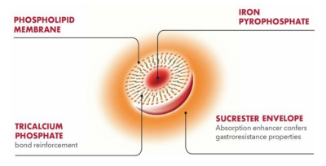
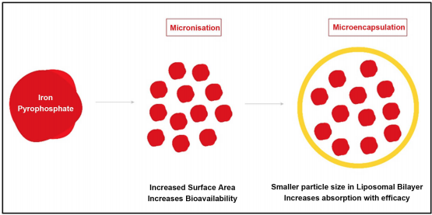
Sucrosomial Iron / Liposomal Iron
Sucrosomial or Liposomal Iron is an innovative oral iron formulation in which ferric pyrophosphate is protected by a phospholipid bilayer plus a sucrester matrix (sucrosome)

Slide 43
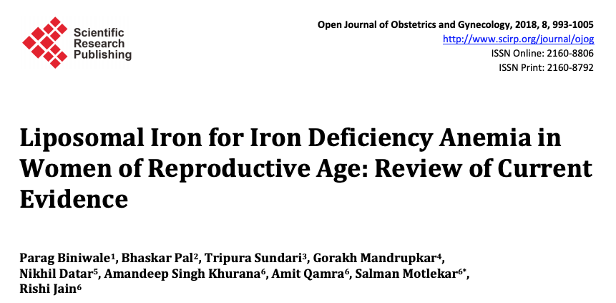
October 2018

Slide 44
Advantages of iron conveyed through I-seal technology
Gastro-resistance property - Better tolerability
Iron absorption unaffected by presence of dietary inhibitors like tea, coffee, milk, calcium, zinc supplements, PPIs and gastric pH
Not regulated by Hepcidin
Data on file;
Barni S. Expert Review of Hematology. 2016;9:sup1, 1-42.
Notes:
Absorption of I-seal iron takes place through specialised cells of the small intestine called as the M cells.
M cells are specialized epithelial cells of the follicle-associated epithelium of the gastrointestinal tract (Peyer’s patches).

Slide 45
Advantages?
Iron absorbed through M Cells of small intestine
Higher bioavailability
No chelation with other metals
No oxidative damage to intestinal epithelium
Quicker and better response
Better compliance
Minimal side effects
Safety established

Slide 46
Mechanism of absorption- different
Endocytosis
Simple adsorption and diffusion
Fusion of lipid bilayer to plasma membrane with release of contents into the cytoplasm
Exchange of lipids between liposomal bilayer and plasma cell membrane
Absorption by microfold cells (M cells) in Peyer’s patches

Slide 47
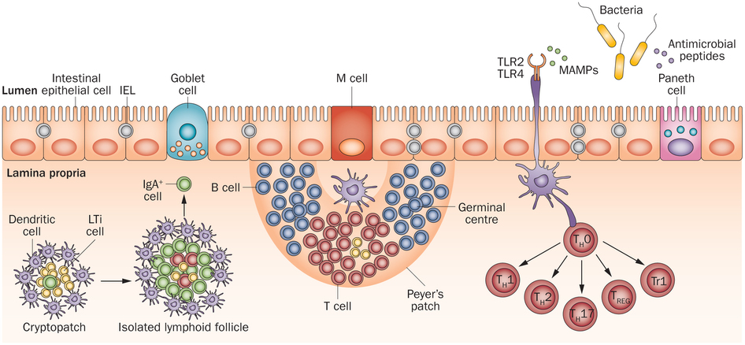
M cells
M cell-mediated translocation is very efficient and is a rapid process.
During this process contents of endosome do not undergo major structural changes and are released intact.
This is because the M cells, due to their low lysozyme content, can transport antigens with almost no enzymatic degradation

Slide 48
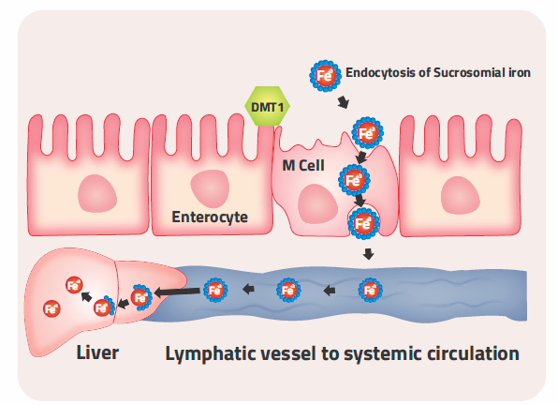
Unique Absorption of I-seal Iron
Data on file;
Barni S. Expert Review of Hematology. 2016;9:sup1, 1-42.
Notes:
Absorption of I-seal iron:
The iron covered by sucrosoma crosses the gastric acid barrier and reaches the small intestine in intact form.
This is directly absorbed into M cells by endocytosis without the need of specific transporters unlike conventional iron.
M cells directly transport I-seal iron through lymphatic system to reach liver in intact form
In the liver, the sucrosoma layer is 'opened' by lysosomal enzymes making iron available.
Trivalent ferric pyrophosphate has high affinity to newly, liver-synthesised transferrin.

Slide 49
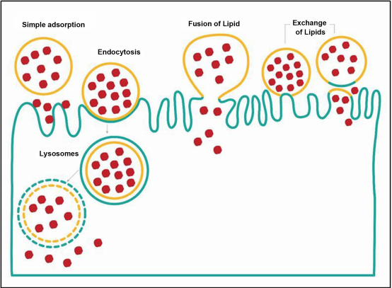
Schematic representation of the mechanisms of absorption
No protein mediated transport: better bioavailability

Slide 50
Absorption of I-seal Iron – via M cells present throughout small intestine
Iron covered by sucrosoma crosses the gastric acid barrier and reaches the small intestine in intact form
This is directly absorbed into the M cells by endocytosis without the need for specific transporters, unlike conventional iron
The M cells directly transport the sucrester iron through the lymphatic system to reach the liver intact
In the liver, the outer sucrester layer and phospholipid bilayer is ‘opened’ by lysosomal enzymes making iron available
Trivalent ferric pyrophosphate form has high affinity to newly liver-synthesized transferrin
Pisani A, et al. Nephrol Dial Transplant. 2015 Apr;30(4):645-52,
Sandro Barni, 4th Mediterranean Multidisciplinary Course on Iron Anemia April 29th – 30th 2016, Madrid, Spain., Expert Review of Haematology 2016, Vol.9, NO.S1, 1-42
Notes:
Absorption of I-seal iron:
The iron covered by sucrosoma crosses the gastric acid barrier and reaches the small intestine in intact form.
This is directly absorbed into M cells by endocytosis without the need of specific transporters unlike conventional iron.
M cells directly transport I-seal iron through lymphatic system to reach liver in intact form
In the liver, the sucrosoma layer is 'opened' by lysosomal enzymes making iron available.
Trivalent ferric pyrophosphate has high affinity to newly, liver-synthesised transferrin.
Thus, in case of I-seal iron, the sucrosoma allows the iron to pass through gastric environment untouched to be absorbed in to the small intestine and is finally released in the liver through lymphatic system. The liposomal protection allows the iron to be absorbed throughout the small intestine unlike conventional iron which is absorbed only in duodenum. The similarity between liposomes and liposomal chylomicrons allows liposomes to be absorbed by the same pathway as chylomicrons are absorbed.

Slide 51
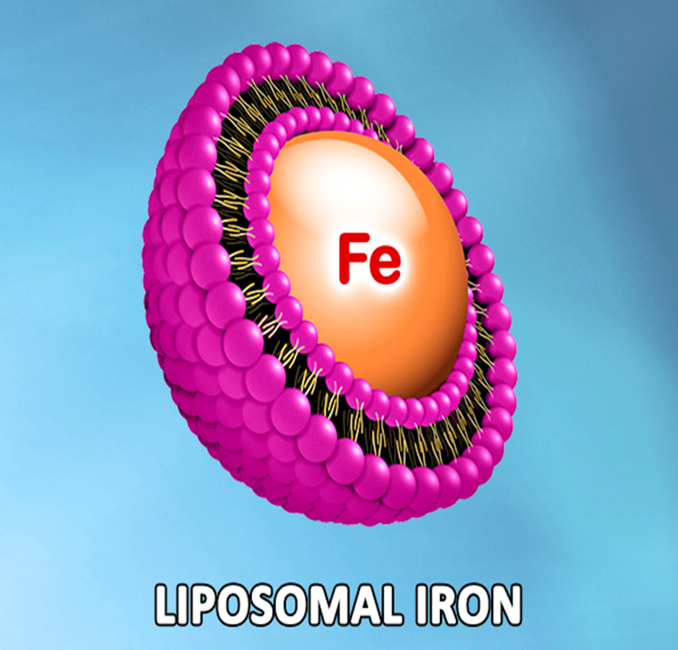
Hepcidin bypassed!
Unique pharmacokinetics
Excellent GI tolerance
Higher bioavailability
Orally administered SI
Lymphatic system
Blood stream

Slide 52
Hepcidin is upregulated by normal iron salts
Normal iron salts induce Hepcidin up-regulation by two ways:
the absorbed iron stimulates peri-portal hepatocytes
the unabsorbed iron triggers an inflammatory response on intestinal mucosa and induces hepsidin production
Less iron is absorbed

Slide 53
Hepcidin is not upregulated by sucrosomial iron
Sucrosomial iron is not released into the portal blood stream, but into the lymphatic circulation and later, the arterial circulation, before reaching the liver
The iron in SI does not interact with duodenal mucosa, as it is protected by the sucrosome, and the phospholipidic bilayer carriers may also exert anti-inflammatory properties
More iron is absorbed

Slide 54
Improved Compliance with minimal GI side effects

Slide 55
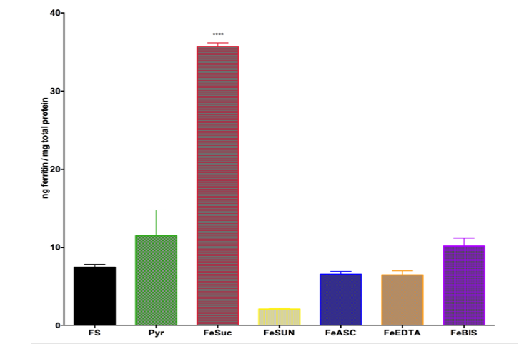
Significantly higher ferritin conc. compared to ferrous sulphate, ascorbic iron & others
Sucrester iron
Bisglycinate iron
Ferrous sulphate
Ascorbic iron
Chelated iron
CACO-2 cells treated with Sucrester iron (FeSuc) showed a significantly higher concentration of Ferritin compared to other iron formulations.
FS Ferrous Sulfate, Pyr Iron pyrophosphate, FeSUN Sunactive iron, FeASC Ascorbic Iron, FeEDTA EDTA-chelated iron, FeBIS bisglycinate iron
Notes:
In an ex-vivo study model, I-seal iron was shown to achieve significantly higher ferritin conc. compared to ferrous sulphate, ascorbic iron and other iron formulations (as published in Blood 2016)

Slide 56
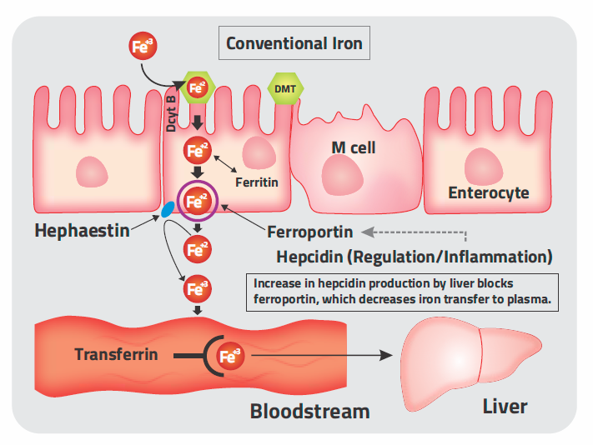
Differences in Absorption of Conventional Iron and I-seal Iron
Conventional iron | I-seal iron
Absorbed in to duodenum | Throughout small intestine
Absorbed by enterocyte | Absorbed by M cells
Acidic pH is required to keep iron in ferrous (absorbable) form | No such requirements
Absorption may be affected by proton pump inhibitors (PPIs) | Absorption unaffected by PPIs
Notes:
Data on file; Barni S. Expert Review of Hematology. 2016;9:sup1, 1-42; ; Gautam CS, et al. Medscape J Med. 2008;10(12):283; Di Renzo GC, et al. Womens Health (Lond). 2015 Nov;11(6):891-900; Khalafallah AA, et al. Pregnancy. 2012;2012:630519; Milman N. J Pregnancy. 2012;2012:514345; Santiago P. Scientific World Journal. 2012;2012:846824.
Conventional iron absorption takes place through the enterocytes of duodenum in small intestine.
Ferric iron is reduced to ferrous form which enters the enterocyte through DMT1 i.e. divalent metal transporter.
In case of heme iron, the absorption occurs by endocytosis and ferrous iron is liberated.
The absorbed ferrous iron may be stored in the enterocyte cells as ferritin or transported through blood.
Ferroportin is the “iron exporter” which transports the iron into the blood, while hephaestin converts the ferrous iron to ferric form.
The ferric iron binds with transferrin which carries iron towards the bone marrow for erythropoesis.
Hepcidin regulates iron homeostasis
Hepcidin binds to the iron exporter i.e. ferroportin inducing its degradation and thus preventing the iron entry into plasma
The hepcidin-ferroportin interaction determines the flow of iron into plasma.
Production of hepcidin is controlled by plasma iron concentrations, erythropoetic activity and inflammation.
Thus, we have seen until now, that hepcidin concentration markedly influences the iron absorption from intestine and can also affect efficacy of oral iron supplements.
In case of I-seal iron:
The iron covered by sucrosoma crosses the gastric acid barrier and reaches the small intestine in intact form.
This is directly absorbed into M cells by endocytosiss without the need of specific transporters unlike conventional iron.
M cells directly transport I-seal iron through lymphatic system to reach liver in intact form
In the liver, the sucrosoma layer is 'opened' by lysosomal enzymes making iron available.
Trivalent ferric pyrophosphate has high affinity to newly, liver-synthesised transferrin.
The similarity between liposomes and liposomal chylomicrons allows liposomes to be absorbed by the same pathway as chylomicrons are absorbed.

Slide 57
Based on hypothesis
Iron with I-seal Technology can especially be beneficial in such cases of pregnancy associated with obesity, gestational diabetes, pre-eclampsia and infections (malaria) since iron absorption occurs through M cells and not through the enterocytes (conventional iron)
Iron absorption in such cases could be hampered with conventional iron due to elevated hepcidin levels
Notes:
Thus, based on hypothesis we can say that:
Iron with I-seal Technology can be beneficial in such cases of pregnancy associated with obesity, gestational diabetes, pre-eclampsia and infections (malaria).
This is because iron absorption occurs through M cells in case of I-seal iron and not through the enterocytes (conventional iron), (wherein iron absorption could be hampered with conventional iron in presence of elevated hepcidin levels).

Slide 58
RECOMMENDATIONS
Age group ICMR | RDA Iron
Adult male | 17 mg
Adult female (Non-pregnant) | 21 mg
Pregnant female | 35 mg
Lactation | 25 mg
ICMR Recommendations 2009
Age ICMR | RDA* Folic Acid
Adult female | 200 mcg/d
Pregnant | 500 mcg/d
Lactation | 300 mcg/d

Slide 59
Clinical studies with Sucrester iron
Notes:
There are clinical studies with I-seal iron in different conditions associated with iron deficiency anaemia.

Slide 60
Safety and efficacy in pregnancy
80 subjects, Iron deficiency without anemia
12–14 weeks of pregnancy to 6 weeks postpartum, given
No iron
Ferrous iron 30 mg/day
Sucrosomial Iron 14 mg/day or
Sucrosomial Iron 28 mg/day
The SI-28 group showed higher Hb and Ferritin levels at 28 weeks and in the postpartum period

Slide 61
Postpartum anemia following PPH
148 consecutive deliveries, 8 non-anemic women (mean Hb: 12.1 g/dL), who developed postpartum anemia due to PPH (mean: 858 mL; range: 700–1600 mL)
Sucrosomial Iron, 60 mg twice daily
After one week, the mean Hb increase was 1.5 g/dL
No gastrointestinal or systemic side effects reported
Review Article:
Berardi, S. et al. Efficacy of oral Sucrosomial® iron in puerperium anemia. Exp. Rev. Hematol. 2016, 9 (Suppl. S1), 40.

Slide 62
Comparison of oral Liposomial Iron with Ferrous Sulphate
In a non-blind randomised control trial, 80 non-anaemic pregnant women were includedat 11-13 weeks of gestation and randomised in to four groups
All the pregnant women were followed till 6 weeks of postpartum
Ferrous Sulphate-30mds, Liposomial Iron 14mgs, 28mgs daily given
Significantly higher haemoglobin and ferritin concentrations in the Liposomial Group compared with controls
Higher birth weight in LI28 (Liposomal iron 28 mg) group compared with controls
Parisi F,et al. J Matern Fetal Neonatal Med. 2016 Sep 2:1-6.
To evaluate the efficacy of supplementation with oral liposomal iron compared to oral ferrous iron

Slide 63
Iron Deficiency Anaemia & Chronic Kidney Disease
A randomized, open-label trial was conducted in 99 patients with chronic kidney disease- not on dialysis (ND-CKD, stage 3-5) and iron deficiency anaemia to determine whether liposomal iron compared with intravenous (IV) iron, improves anaemia in ND-CKD patients
Oral Liposomial Iron against IV
Iron Gluconate 125mgswkly upto a total of 1000mgs
No significant difference between the two treatment groups with respect to Hb rise and transferrin saturation
This study shows that oral liposomal iron is a safe and efficacious alternative to intravenous iron gluconate to correct anaemia in ND-CKD patients.
Pisani A,et al. Nephrol Dial Transplant. 2015 Apr;30(4):645-52

Slide 64
Conclusion
1. Similar Hb rise in both groups
2. Significantly less AEs (3.1 vs 34.5%, P < 0.001)
3. Adherence was similar in both groups
1. More rapid Hb rise initially
2. Replenishment of iron stores was greater
Liposomial Iron
IV Iron
Pisani A,et al. Nephrol Dial Transplant. 2015 Apr;30(4):645-52.
64
Notes:
This study shows that oral liposomal iron is a safe and efficacious alternative to intravenous iron gluconate to correct anaemia in ND-CKD patients.

Slide 65
Anaemia of Chronic Disease
21 young female patients with anaemia of chronic inflammatory disease randomised to 2 groups
Group A (n=9): liposomal iron 60 mg/d PO for 3 months
Group B (n=12): iron sulfate 210 mg/d PO for 3 months
Liposomal iron is safe, well tolerated and more effective than iron sulfate in the treatment of anaemia of chronic inflammatory disease of young.
Giordano G, et al. Poster presentation.
Available from: http://www.artoi.it/wp-content/uploads/2013/11

Slide 66
Results and Conclusion
In iron sulfate treatment group, 4 patients reported epigastralgia, 2 constipation and 5 diarrhoea
Giordano G, et al. Poster presentation.
Available from: http://www.artoi.it/wp-content/uploads/2013/11/Abstract_Giordano_Giulio2.pdf.
Notes:
After treatment, liposomal iron group showed rise of hemoglobin level from median 8.5 g/dl to 11.5 g/dl (median rise was 3 g/dl) while ferrous iron showed rise of hemoglobin level from median 9.0 g/dl to 9.5 g/dl (median rise was 0.5 g/dl)
Liposomal iron is safe, well tolerated and more effective than iron sulfate in the treatment of anaemia of chronic inflammatory disease of young.

Slide 67
Iron Deficiency Anaemia with Inflammatory Bowel Disease
Title | Methods | Results | Conclusion
Comparison between liposomial iron and ferrous sulfate in patients with iron deficiency anemia and inflammatory bowel disease. A pilot controlled study | N=34, 12 weeks; IDA with IBD Grp A: Liposomal iron 30 mg/day (n=11) Grp B: Iron sulphate 105 mg/day (n=12) Grp C: No iron treatment (n =11) | A: Hb rise from 10.5 to 12.4 g/dL B: Hb rise from 10.8 to 11.7 g/dL C: Hb rise from 11.3 to 11.9 g/dL No side effects | More Hb is increased in liposomal iron group compared to iron sulphate group.
Indriolo A, et al. Comparison between liposomial iron and ferrous sulphate in patients with iron deficiency anemia and inflammatory bowel disease. A pilot controlled study. 2014. Poster presentations: Therapy & Observation: P530. Italy.
Notes:
There was a rise of Hb from 10.5 to 12.4 g/dl in (Liposomal iron 30 mg/day) group A, from 10.8 to 11.7 g/dl in (iron sulfate 105 mg/day) group B and from 11.3 to 11.9 g/dl in group C (no treatment group)
• There was more rise in Hb in liposomal iron group than iron sulphate group
• Liposomal iron was well tolerated
• Liposomal iron could be a therapeutic option in patients with iron deficiency anaemia associated with inflammatory bowel disease

Slide 68
Efficacy in Chemotherapy Related Anaemia
Title | Methods | Results | Conclusion
Safety and efficacy of oral liposomal iron supplemented in cancer patients with chemotherapy related anaemia receiving epoeitin alfa. | N=72, Chemotherapy related anaemia Liposomal iron 30 mg/day + Epoeitin alpha 40000 IU SC/week for 8 weeks | At the end of 8 wks, mean increase in Hb was 2.2 g/dl 95% patient responded (20% rise in Hb) Improvement in QOL parameters | Daily supplementation of LI is safe and produces a significant increase in Hb with improved QOL.
Prestifilippo A, et al. Safety and efficacy of oral liposomal iron supplemented in cancer patients with chemotherapy related anaemia receiving epoeitin alfa. Poster presentation III: 1565P. ESMO Congress, 2012.
Notes:
In this prospective study, 72 patients of chemotherapy related anaemia were receiving chemotherapy and epoeitin alfa (40000 U wekly) plus oral liposomal iron (LI) 30 mg once daily for 8 weeks.
Primary endpoint was haemoglobin (Hb) response (increase Hb level ≥ 2 g/dl from baseline).
At the end of 8 weeks, mean increase in Hb was 2.2 g/dl
None of the patients required red blood cell transfusion
Administration of oral LI was well tolerated in all patients
Improvement in QOL parameters was observed in all patients

Slide 69
Efficacy in Chemotherapy Related Anaemia versus Intravenous Iron
Title | Methods | Results | Conclusion
Randomized Phase II Trial of supplementation with oral liposomal iron versus intravenous iron in patients with chemotherapy-related anemia without Iron deficiency treated with Darbepoetin Alfa | N= 64, chemotherapy related anemia Ferric gluconate 125 mg IV weekly X 8 wks (n=31) Vs Oral liposomal iron 30 mg daily X 8 wks (n=33) + All received darbepoetin alfa 500 mcg once every 3 wks | Similar rise in Hb in both groups Liposomal iron: response in 70% pts IV iron: response in 71% pts. (Response: Hb increase ≥ 2 g/dl from baseline or attainment of ≥ Hb 12 g/dl.) | Oral LI provides similar increase in Hb with better tolerability and more convenient administration
Mafodda A, et al.. ESMO (European Society for Medical Oncology) Congress, Vienna, Austria, 1 October 2012..

Slide 70
Safety of I-seal Iron
Safe and tolerable
AEs in clinical trials were minimal and of mild nature
Less incidence compared to other iron preparations
In study conducted by Pisani et al, 3.1 % patients had drug-related AEs compared to 34.5 % patients in IV iron group
Most common AEs were
Constipation (4.5%)
Diarrhea (4.5%)
Pisani A,et al. Nephrol Dial Transplant. 2015 Apr;30(4):645-52.
Notes:
Safety of I-seal iron has been evaluated in many clinical trials. I-seal iron reaches the small intestine unscathed avoiding the pro-oxidant effects of iron salt. Moreover, avoidance of direct contact of iron with intestinal mucosa minimises irritating side effects on mucosa. Adverse events observed with I-seal iron in clinical were minimal and mild in nature. Incidences of adverse events with I-seal iron were less compared to other iron preparations.
In a study conducted by Pisani et al, only 3.1% patients in I-seal iron experienced possibly drug-related adverse events compared to 34.5% patients in intravenous group (p <0.001).

Slide 71
To conclude…
Some simple measures that work wonders …

Slide 72
Blood transfusion?

Slide 73
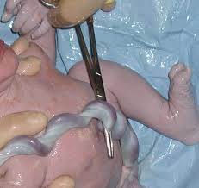
Yes, placental transfusion!
By delayed cord clamping…
“The common method of tying and cutting the navel string in the instant the child is born, is one of those medical errors in practice that has nothing to plead in its favour but custom”
– Charles White

Slide 74
Placental transfusion
Early cord clamping – within 1 minute after birth-X
Delayed cord clamping – 1 to 3 minutes after the birth or when cord pulsation has ceased

Slide 75
Cord clamping for the prevention of iron deficiency anemia in infants: optimal timing
About 30% more blood flows into the baby and adds about 50mg of iron to the baby’s iron stores
Nature intended for babies to get their iron from placental transfusion, because breast milk is not rich in iron

Slide 76
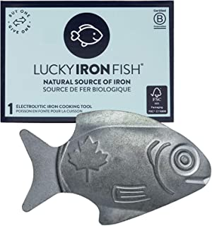
Iron from the ‘lucky iron fish’ …
M.R.P.: ₹ 8,999.00
Price: ₹ 5,490.00 FREE Delivery
Notes:
Wash your Fish with soap, water and a soft cloth.
Boil in 1 litre of water or broth with 2-3 drops of citrus juice (or other form of acidity) for 10 minutes, then remove.
Add ingredients as normal and enjoy your iron rich meal! the Lucky Iron Fish is 100% Vegan and has no side effects

Slide 77
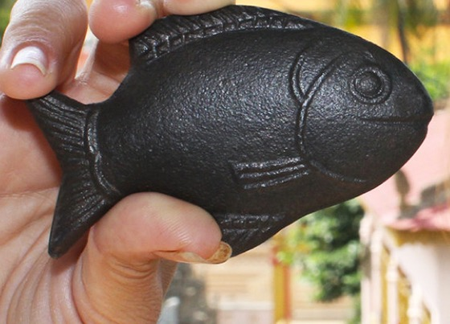
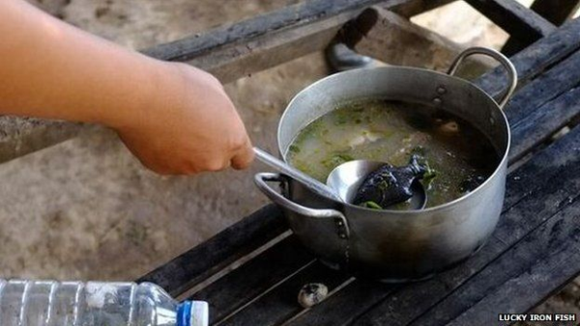
Notes:
Lucky Iron Fish are fish-shaped cast iron ingots used to provide dietary supplementation of iron to individuals affected by iron-deficiency anaemia. The ingots are placed in a pot of boiling water to leach elemental iron into the water and food. We do not recommend using the Lucky Iron Fish if you have a hemoglobin variant such as Hemochromatosis. Started in Cambodia by Dr Christopher Charles

Slide 78
Iron strengthens …

